Slide 1
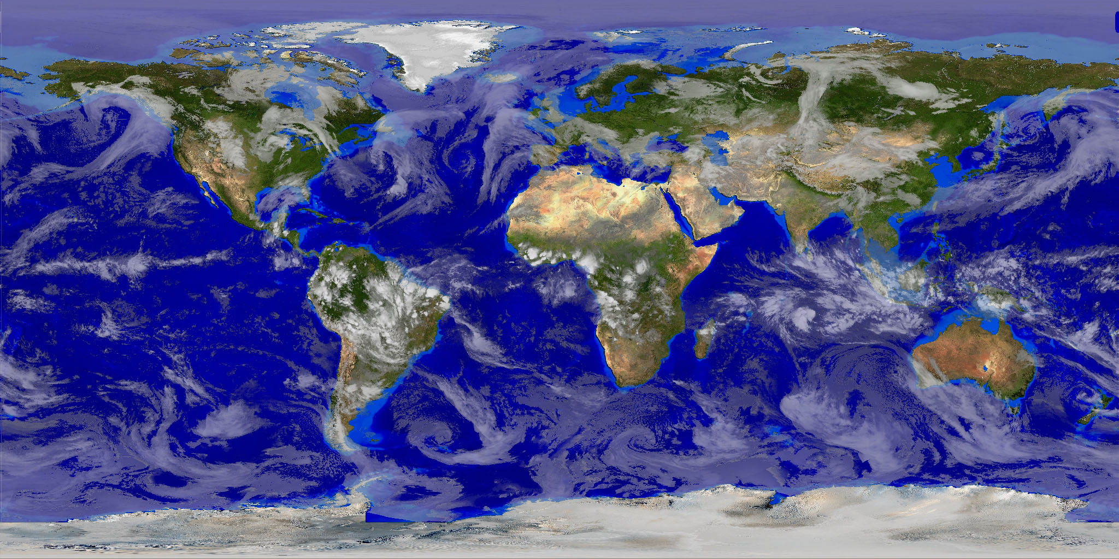
Physical Earth/Climate: Wind and Atmospheric Pressure
Mr. Bergum

Slide 2
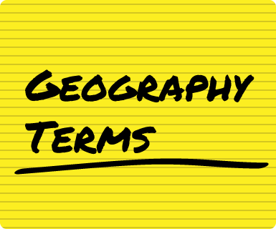
Terms to Know:
Prevailing Winds Westerlies
Atmospheric Pressure Trade Winds
Polar High Pressure Zone
Subpolar Low Doldrums
Equatorial Low
Subtropical High

Slide 3
Questions to Answer:
How does wind affect a regions climate? (What does it bring?)
Where are the four major pressure zones and how do they work?
What winds and pressure zones affect the state of Utah?

Slide 4
I. Wind and Climate
A. All winds are caused by direct sunlight on the equator, heats the air, causes it to rise, forming an equatorial low pressure.
B. Winds affect climate by carrying moisture/bringing rainfall.
C. The prevailing winds of an area are places on the earths surface where winds blow in the same direction most of the time.

Slide 5
I. Wind and Climate
D. The two main prevailing winds that affect most populated areas are:
1. The trade winds: Flow Northeast and Southeast towards the equator. (Tropical Storms)
2. The Westerlies: Flow West to East, From Subtropical High to Subpolar Low Pressure. (U.S. Weather)
E. Right along the equator there is a zone called the doldrums or an area of low pressure where prevailing winds are calm.

Slide 6
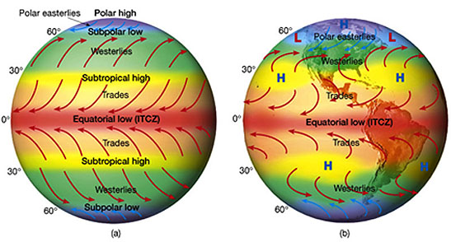
II. Atmospheric Pressure and Climate
A. Air creates atmospheric pressure or weight of the air that is always pushing down on you (changes at different places around the globe).
B. When air is warmer it creates low pressure air becomes less dense and rises (cools and forms clouds).
C. When air is cooler it creates high pressure cold air is dense and sinks down toward the surface (warms and dries the area out).

Slide 7
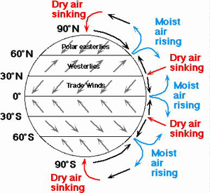
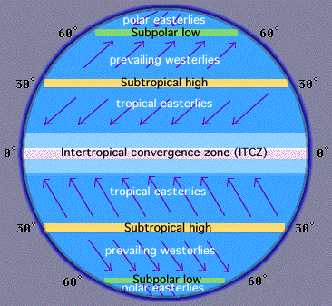
II. Atmospheric Pressure and Climate
D. There are 4 major pressure zones in the world:
1. The equatorial low zone is The Inter-tropical Convergence zone (ITCZ), Trade winds converge on the equatorial low.
2. The sub-tropical high zone is where most of the earth’s deserts are located.
3. The sub-polar low zone is where air rises, creates an area of low pressure (Temperate Forests).
4. The polar high zone has cold temperatures cause air to descend and create high pressure, coldest temperatures and low precipitation (Polar Deserts).

