Slide 1
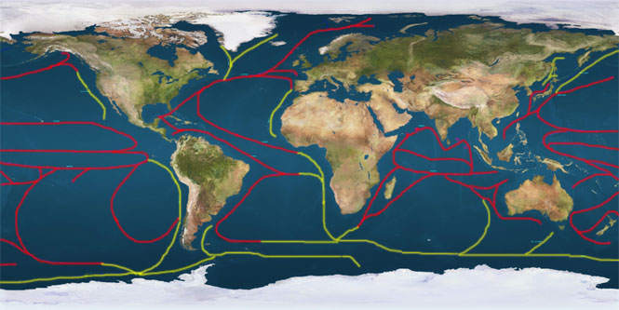
Physical Earth- Ocean Currents and Landforms
Mr. Bergum

Slide 2
Terms to Understand
Currents
Precipitation
Lake Effect
Rain Shadow
Windward
Leeward

Slide 3
Questions to Answer
How do ocean currents and large bodies of water affect the climate on land?
How does climate vary from one side of the mountain to another and why?
How do the mountains and Great Salt Lake affect the climate of the Salt Lake Valley?

Slide 4
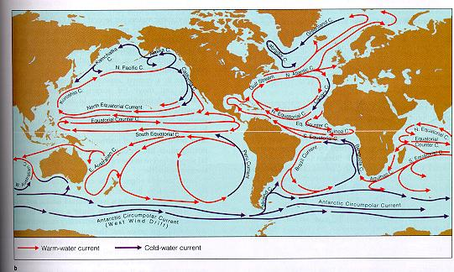
I. Ocean Currents and Climate
A. Water currents are caused by uneven heating of the earths oceans by sunlight.
B. Also, generally speaking, land located near water usually has milder climates (not as extreme).
C. This happens because water maintains a stable temperature.

Slide 5
I. Ocean Currents and Climate
D. Currents affect the land in two simple ways:
1. A cold current will cool the land.
2. A warm current will warm the land.
E. Large lakes and seas can also produce the lake effect or an increase in precipitation due to an increase in evaporation.

Slide 6
II. Landforms and Climate
A. Mountains have a large impact on the amount of precipitation an area receives.
B. The term precipitation means a product of condensation, deposited on the earths surface.
C. The windward side, facing the wind, forces the air up and over the mountain.
Tibetan Plateau

Slide 7
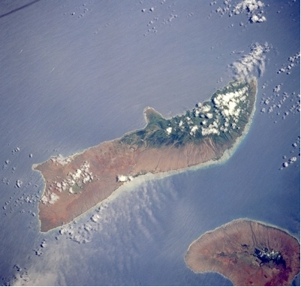
II. Landforms and Climate
D. As it rises the air cools, water condenses.
E. This causes heavy precipitation on the windward side.
F. As it comes down the leeward side, facing away from the wind, the air warms as it descends and soaks up moisture.
G. The area on the leeward side is also called a rain shadow, dry region of land, on the leeward side of the mountain. “Shadow of Dryness”.
Molokai, Hawaii

