Slide 1
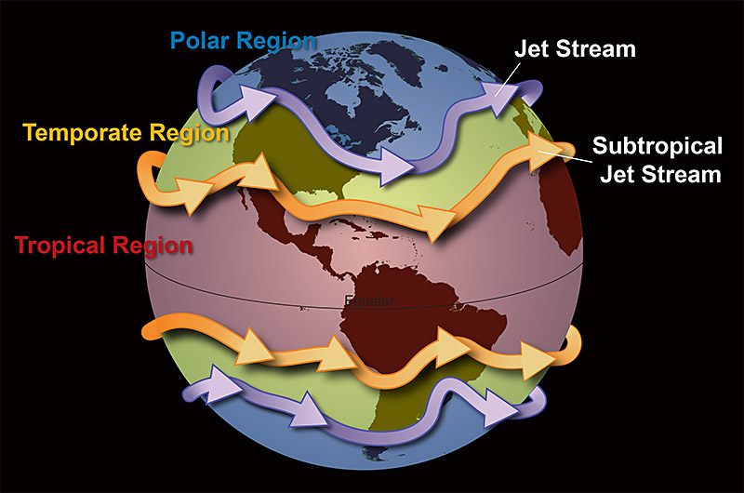
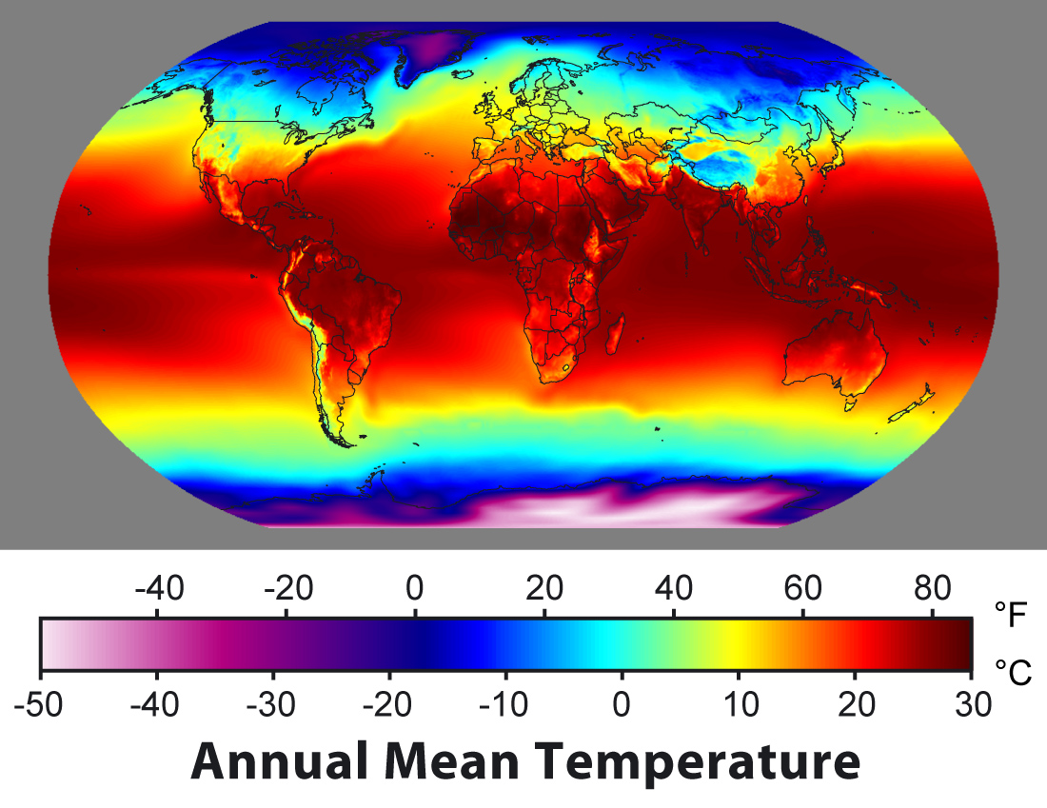
Climate: Latitude and Elevation
Mr. Bergum

Slide 2
Physical Earth Day 2: Climate- latitude and elevation
Terms to know:
-Latitude belts -polar region -temperate regions -tropics – arctic circle -Antarctic circle
Questions to answer:
-What effect does latitude have on climate?
-in what ways does elevation affect climate regardless of the latitude?
-Which latitude belt has the greatest variety of climates and why?

Slide 3
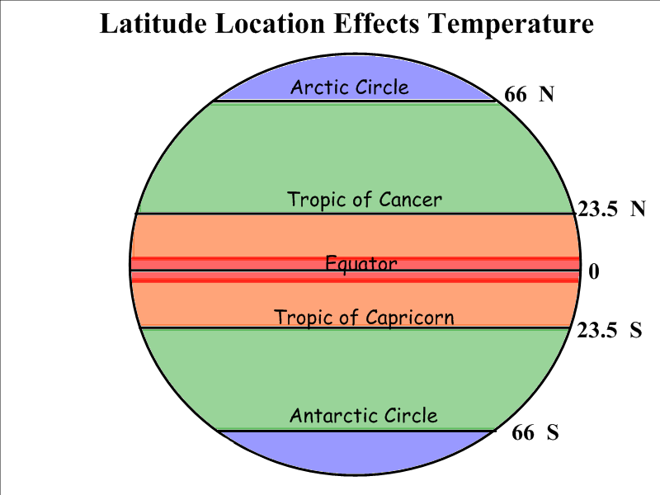
I. Latitude and Climate
Generally speaking the closer to the equator you are, the warmer it is.
This is because of more direct sunlight.
There are three latitude belts, these are areas on the earth with similar climates based on latitude.
The low latitudes or tropics are 0-23.5 degrees latitude N and S of the equator, Tropics are warm and wet.
The mid latitudes or temperate regions are 23.5-66.5 degrees latitude, temperate regions are hot/cold depending on the season.
The high latitudes or polar regions are 66.5-90 degrees latitude, these regions are cold b/c the poles get the least amount of direct sunlight.

Slide 4
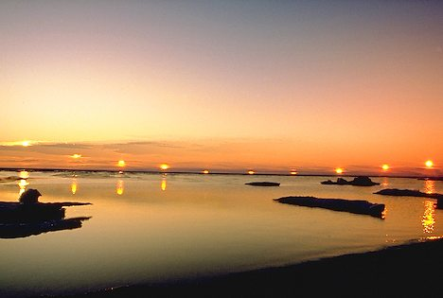
I. Latitude and climate continued
D. It is important to remember that the southern hemisphere is reversed/flipped from the northern hemisphere.
e. Two more important lines of latitude to remember:
1. the Arctic circle, located at 66.5 N
2. the Antarctic circle, located at 66.5 s
F. These polar circles mark the areas of the earth that receive 24 or more continual hours of sunlight/darkness during the solstices.

Slide 5
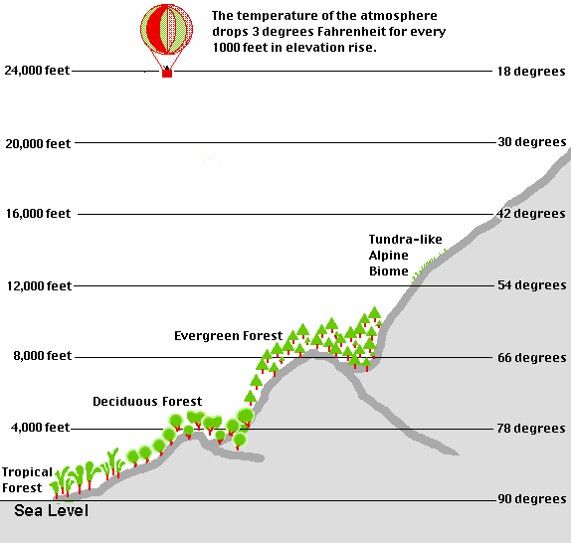
II. Elevation and climate
Generally speaking the higher up you go (elevation), the cooler it is
This is because the air is thinner and does not hold as much heat as air at earths surface.
On average the temperature decreases 3.5 degrees for every 1000 ft. up you travel.

