Slide 1
Chapter 4
An Introduction to Human Geography
The Cultural Landscape, 8e
James M. Rubenstein
Folk and Popular Culture

Slide 2
“Fish are friends, not food.”
Finding Nemo
“I’m just one stomach flu away from my goal weight.”
The Devil Wears Prada
“My Precious”
Lord of the Rings: The Two Towers
“We are going to need a bigger boat.”
Jaws

Slide 3
“…Father to a murdered son. Husband to a murdered wife. And I will have my vengeance, in this life or the next.”
Gladiator
“Want to know how I got these scars?”
The Dark Knight
“I’ll be back.”
The Terminator
“And in the morning, I’m makin’ waffles!”
Shrek

Slide 4
“Hello. My name is Inigo Montoya. You killed my father. Prepared to die.”
The Princess Bride
“May the odds be ever in your favor.”
Hunger Games
“May the force be with you.”
Star Wars
“Show me the money!”
Jerry Maguire

Slide 5
Terms
Culture Traits: The smallest distinctive item of culture. Learned behavior ranging from language, tools, or games
Culture Complex: Individual traits that are functionally interrelated.
Culture System: When distinctive places share a culture complex
Culture Regions: Areas of the world occupied by people that share recognizable and distinctive cultural traits
Culture Realms: are a set of culture regions showing related culture complexes and landscapes.

Slide 6
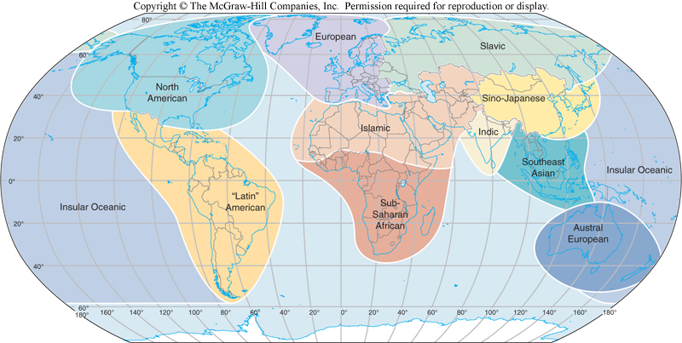

Slide 7
More Terms to remember (Chapter 1)
Environmental determinism
Possibilism
Culture Hearths
Diffusion
Expansion diffusion
Contagious
Hierarchical diffusion
Stimulus diffusion
Relocation diffusion

Slide 8
Even More Terms
Mentifacts: the abstract beliefs passed from one generation to the next as part of the Ideological subsystem of culture
Artifacts: are material objects used to fill our basic needs, part of the technological subsystem
Sociofacts: define the social organization of a group and include all relationships including family, economic, military, religious, etc.

Slide 9
Introduction
This chapter looks at material culture including survival items like food, shelter, and clothing, and also leisure activities such as arts and recreation. Non-material culture such as religion, beliefs, language, etc will be discussed later.
Habit vs custom
Habit is an act preformed repeatedly by an individual
Custom is a repeated act by a group so much that it becomes a characteristic

Slide 10
Folk vs. Popular Culture
Folk culture is traditionally practiced by small groups that live in isolated rural areas.
Popular culture is found in large societies that share certain habits. Practice by more people that folk cultures

Slide 11
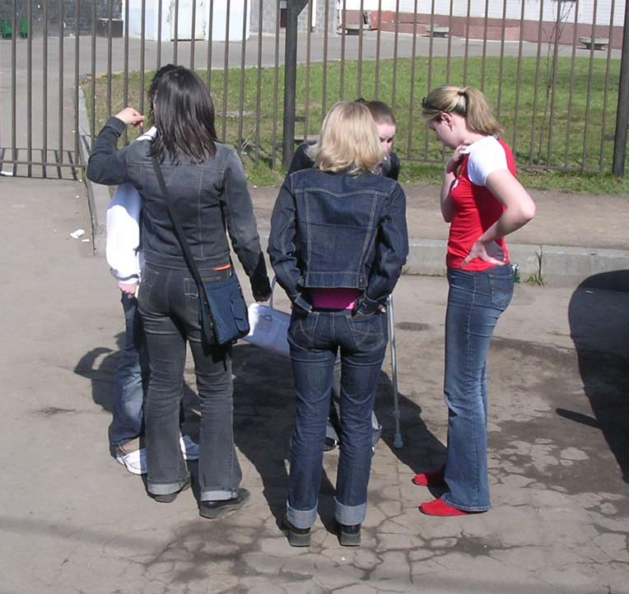
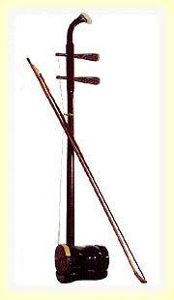
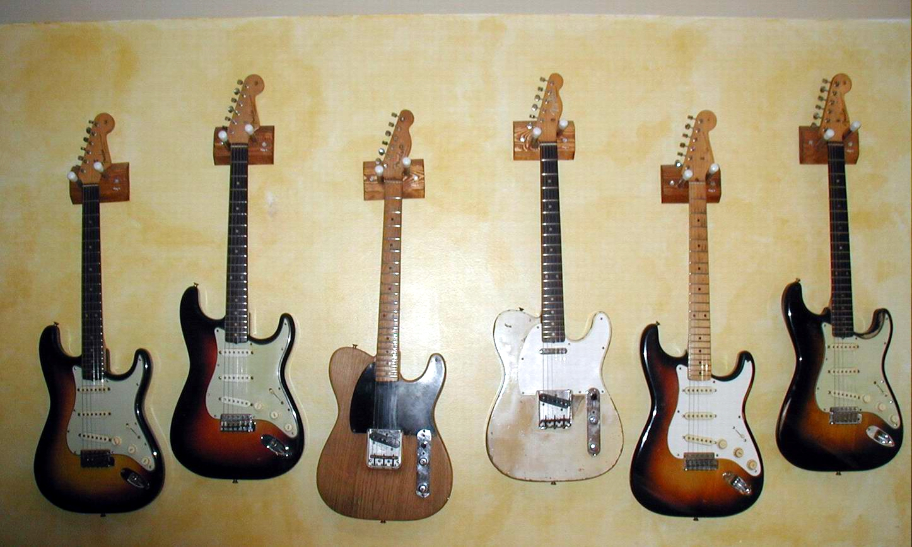
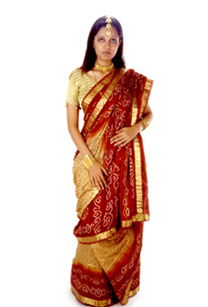

Slide 12
Key Issue 1: Origins and Diffusion of Folk and Popular Cultures
Where do folk and popular cultures originate and diffuse?
Two basic factors help explain the spatial differences between popular and folk cultures.
The process of origin
The pattern of diffusion

Slide 13
Origin of folk and popular cultures
Cultural traits originate at a HEARTH, or center of innovation.
Folk culture often have an anonymous hearth, originate from anonymous sources, at unknown dates, through unidentified originators.
Popular culture is usually a product of developed countries. North America, Western Europe, and Japan are common popular cultural hearths. Fast food, and music are good examples

Slide 14
Origin of Folk Music
Chinese Legend says music was invented in 2697 BC by a guy who cut bamboo poles that would make sound like a phoenix bird
Folk songs usually have anonymous authors, they are transmitted orally, are often modified, and tell stories of everyday life that is familiar to the people.
Folk customs may have multiple origins by groups that don’t have communications with each other. Country music is an example

Slide 15
Origin of Country Music
Fig. 4-1: U.S. country music has four main hearths, or regions of origin: southern Appalachia, central Tennessee and Kentucky, the Ozark-Ouachita uplands, and north-central Texas.

Slide 16
Origins of Popular Music
Popular music is written by specific people for the purpose of being sold to a large audience.
Popular music originated along 28th street in NYC to produce music for variety shows in Western Europe and USA. “Pluggers” pounded out songs for publishers. The area became known as “Tin Pan Ally”. TPA moved several times before recorded music became more popular than sheet music.

Slide 17
Tin Pan Alley and Popular Music
Fig. 4-2: Writers and publishers of popular music were clustered in Tin Pan Alley in New York City in the early twentieth century. The area later moved north from 28th Street to Times Square.

Slide 18
A Mental Map of Hip Hop Hip Hop begins in NYC in the 70s and spreads to other large cities in the 80’s. Lots of Hip Hop is place oriented.
Fig. 4-3: This mental map places major hip hop performers near other similar performers and in the portion of the country where they performed.

Slide 19
Diffusion of Folk and Popular Culture.
Popular culture usually spreads by Hierarchical diffusion from hearths (or nodes) of innovation. Examples include Hollywood for film, Madison Ave for Advertising, NYC, Paris, Milan for fashion
Folk Culture spreads slowly usually through migration (relocation diffusion) rather than from modern methods such as electronics.

Slide 20
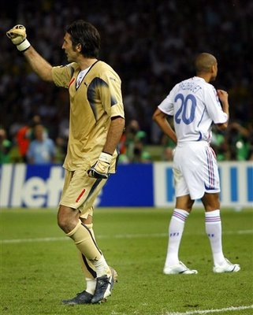
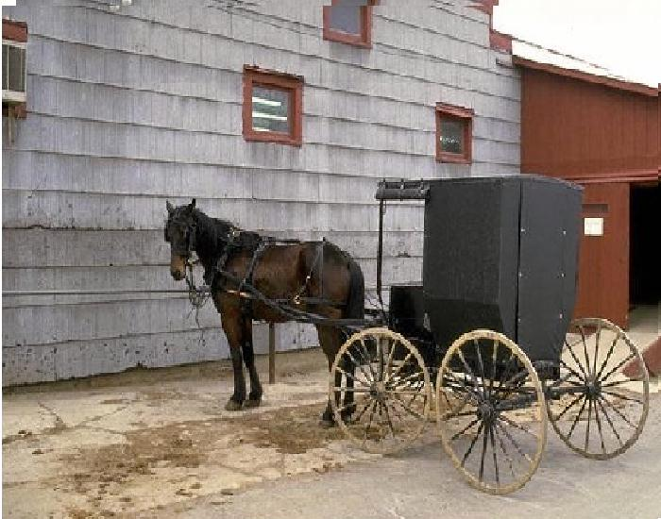
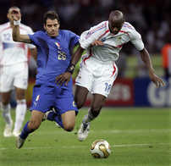
Two Examples

Slide 21
Questions to Answer for Notes
Describe and explain the Relocation diffusion of the Amish
Describe and explain the Hierarchical diffusion of Soccer and explain how it transformed from a folk sport to a popular sport (globalization)

Slide 22
Amish Settlements in the U.S.
Fig. 4-4: Amish settlements are distributed through the northeast U.S.

Slide 23
Key Issue 2: Why Is Folk Culture Clustered?

Slide 24
Influence of the physical environment
Shoes.
Fur lined boots in arctic
Wooden shoes in the Netherlands
Distinctive food preferences
Environment determines what foods can be grown
People take what is available and modify and use it based on cultural preferences.
Taboos and Attractions (know some examples, Rubenstein 123-125)

Slide 25
Hog Production and Food Cultures
Fig. 4-6: Annual hog production is influenced by religious taboos against pork consumption in Islam and other religions. The highest production is in China, which is largely Buddhist.

Slide 26
Folk Housing & The Environment
Folk housing
Determined by available resources and social preferences.
Different places use same material, but orientation and form of the houses are different.
Examples: Madagascar, Laos, Thailand.
(ALSO Feng Shui) for orientation and China for form.

Slide 27
House Types in Western China
Fig. 4-8: Four communities in western China all have distinctive house types.

Slide 28
Isolation Promotes Cultural Diversity
Himalayan art
Different groups of people in the Himalayas developed different art based on their religion and views of the environment.
Buddhists, Hindus, Muslims, Animists
They also display unique forms of dance, music, crafts, and architecture.

Slide 29
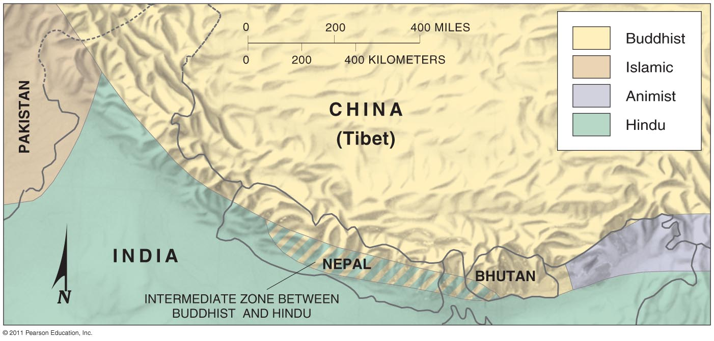
Beliefs and Folk House Forms
Himalayan Folk Cultural Regions
Sacred spaces
Fig. 4-5: Cultural geographers have identified four distinct culture regions based on predominant religions in the Himalaya Mountains.

Slide 30
Home Locations in Southeast Asia
Fig. 4-7: Houses and sleeping positions are oriented according to local customs among the Lao in northern Laos (left) and the Yuan and Shan in northern Thailand (right).

Slide 31
U.S. Folk Housing
Early colonists built vernacular houses, based on tradition but without formal plans
Several different Hearths developed
Northern or New England
French influence in Canada and other French settlements
Other influences from Dutch, Germans (Dutch doors)
Middle Atlantic
Ethnically diverse, developed the log cabin, four over four and I house
Lower Chesapeake
Built from a mix of many influences, one type is the shotgun house with roots in Africa
Interior and western
Sod, balloon frame, Spanish Adobe, and central-hall are examples

Slide 32
Diffusion of House Types in U.S.
Fig. 4-9: Distinct house types originated in three main source areas in the U.S. and then diffused into the interior as migrants moved west.

Slide 33
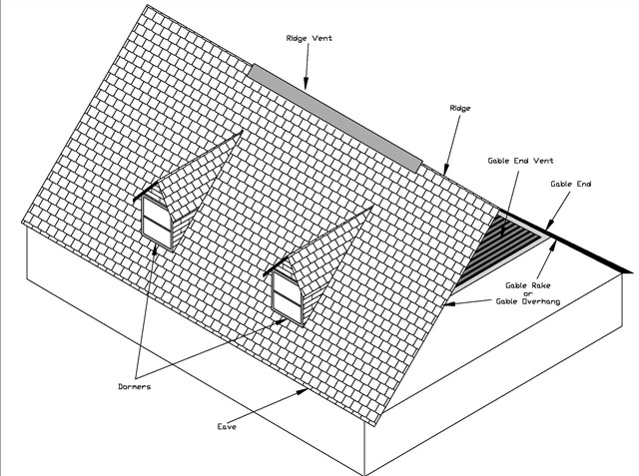
Diffusion of New England House Types
Fig. 4-10: Four main New England house types of the eighteenth and nineteenth centuries diffused westward as settlers migrated.

Slide 34
Key Issue 3: Why Is Popular Culture Widely Distributed?

Slide 35
Popular food customs
Consumption of Snack foods and alcohol are part of Pop Culture but vary within regions of MDCs
Snack Foods:
Southerners prefer pork rinds
northerners prefer popcorn and potato chips
Texans prefer tortilla chips
Westerners prefer multi-grain chips

Slide 36
Alcohol
Bourbon in Upper South
Tequila in Southwest
Canadian Whiskey in the North
Southeast has low consumption
Consumption depends on two factors:
High income
National advertising

Slide 37
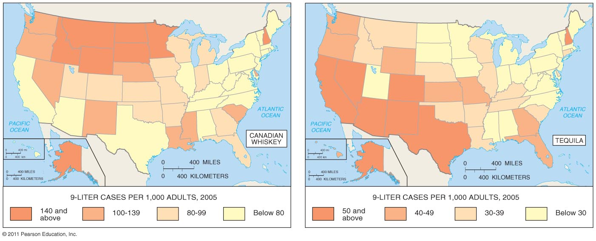
Alcohol Preferences in the U.S.

Slide 38
Wine
Wines are produced all over, but the type of wine show regional preferences or characteristics of the environment.

Slide 39
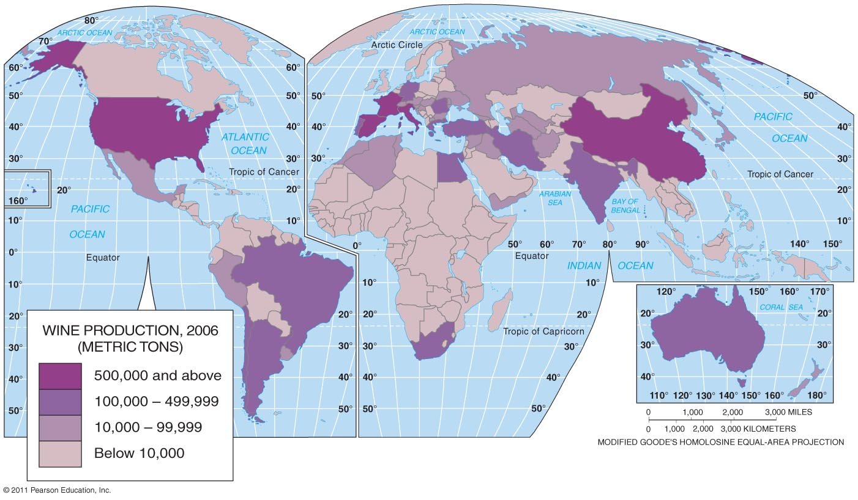
Wine Production per Year
Fig. 4-13: The distribution of wine production shows the joint impact of the physical environment and social customs.

Slide 40
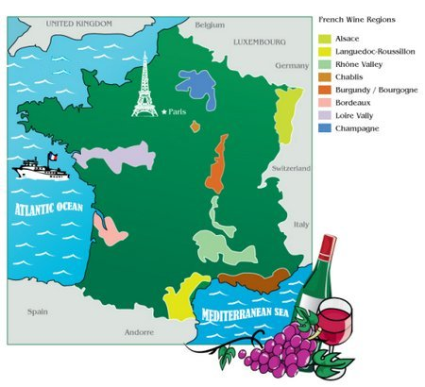

Slide 41
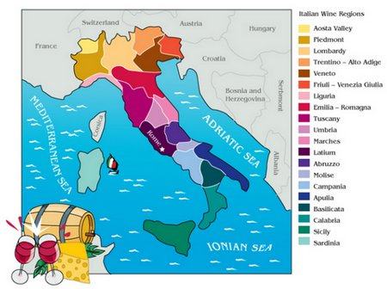

Slide 42
Rapid diffusion of clothing styles
Clothes are not subject to physical barriers such as Mountains.
Clothes often reflect occupation
Clothes often reflect income
In the last several years more info between LDCs and MDCs has led to the sharing of clothing styles.
Some traditional clothing is kept to preserve the past or attract tourists

Slide 43
Diffusion of Jeans
Diffusion of Jeans (you should have 4 facts on your worksheet)

Slide 44
Popular housing styles
Housing since the 1940s has reflected changing fashion rather than function.
Different times periods have made certain house styles popular
40s and 50s minimal traditional
50s and 60s Ranch house
50s -70s split level
50s-70s Contemporary
Late 60s Shed

Slide 45
Neo-Eclectic (Since 1960)
Since 1960s Neo (new) styles of old forms
Mansard
Neo-Tudor
Neo-French
Ne0-Colonial

Slide 46
U.S. House Types, 1945–1990
Fig. 4-11: Several variations of the “modern style” were dominant from the 1940s into the 1970s. Since then, “neo-eclectic” styles have become the dominant type of house construction in the U.S.

Slide 47
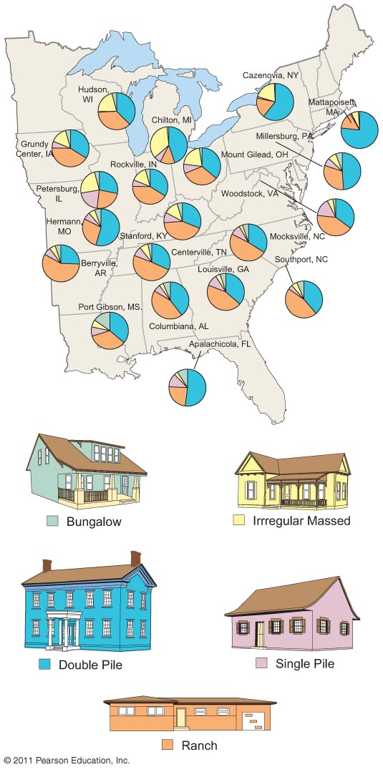
U.S. House Types by Region
What examples have you seen?
Why style is your house?
Fig. 4-1-1: Small towns in different regions of the eastern U.S. have different combinations of five main house types.

Slide 48
Diffusion of television
Rapid diffusion of TVs in the USA
1945 10,000
1949 1 million
1951 10 million
1959 50 million
Diffusion to other countries
1950 85% of TVs were in the USA
1990s 900 million TVs and less than 25% in USA
Four levels of TV countries. Everyone has one, most everyone has one, exist but not widely used, and very few have one.

Slide 49
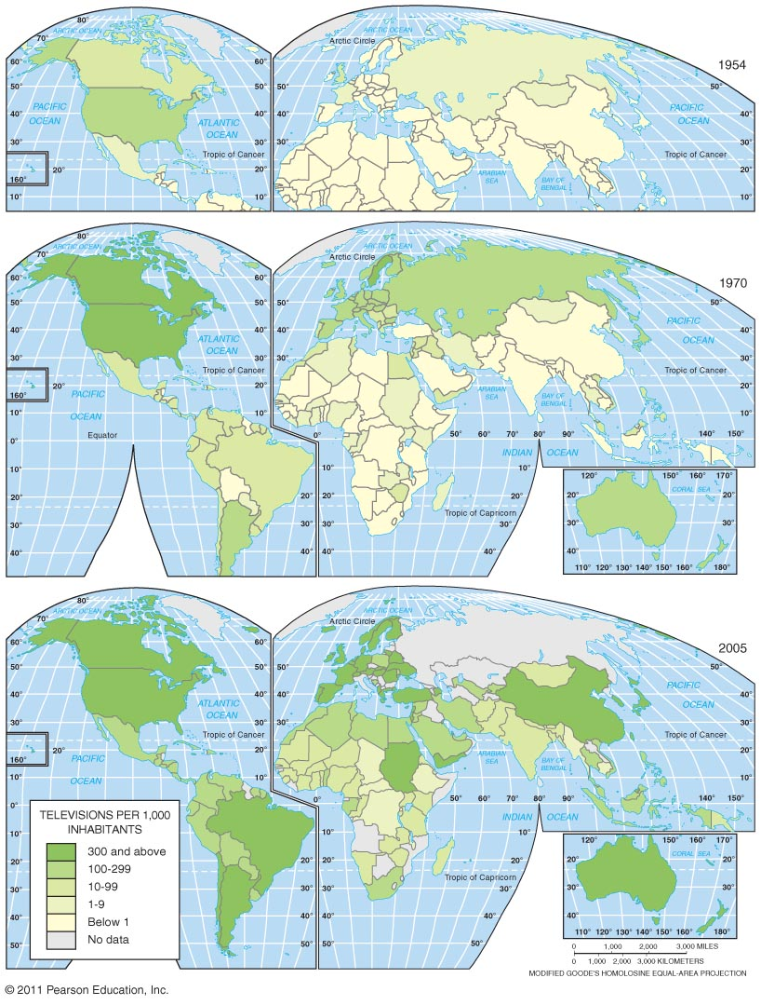
Diffusion of TV, 1954–1999
Fig. 4-14: Television has diffused widely since the 1950s, but some areas still have low numbers of TVs per population.

Slide 50
Diffusion of the internet
Following a similar path of TVs
Initially grows rapidly in MDCs
Spreads to LDCs where it is adopted based on financial capability of each region.

Slide 51
Distribution of Internet Hosts
Fig. 4-15: The U.S. had two-thirds of the world’s internet hosts in 2002. Diffusion of internet service is likely to follow the pattern of TV diffusion, but the rate of this diffusion may differ.

Slide 52
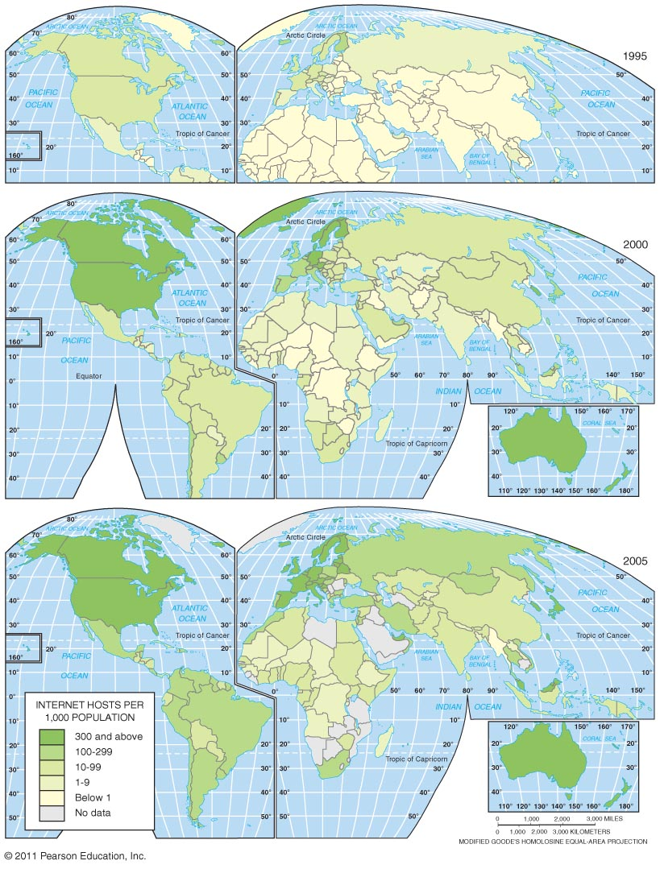

Slide 53
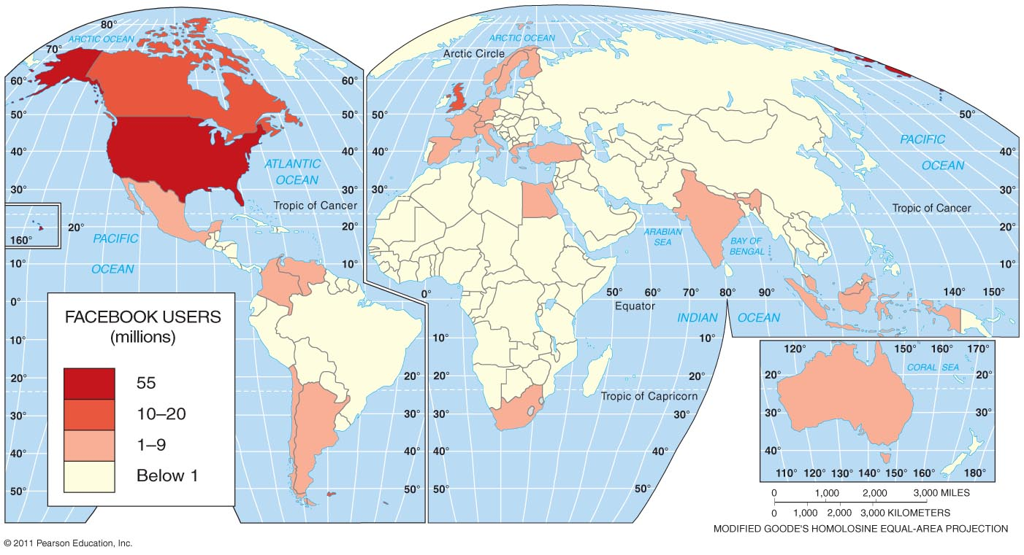
Facebook

Slide 54
Key Issue 4: Why Does Globalization of Popular Culture Cause Problems?

Slide 55
Impacts of the Globalization of Popular Culture
Threats to folk culture
Loss of traditional values
Foreign media dominance
Environmental impacts of popular culture
Modifying nature
Uniform landscapes
Negative environmental impact

Slide 56
Threat #1: Loss of traditional values
Adoption of western clothing styles by business and government leaders in LDCs
Business suits are seen as a symbol of authority and leadership and has been adopted by the world
Middle Eastern countries often battle between the influence of western fashion and traditional Islamic fashions

Slide 57
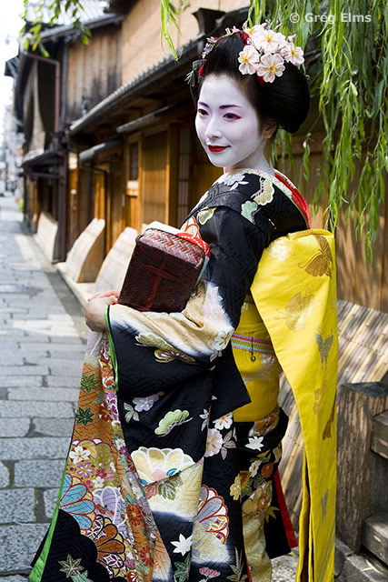
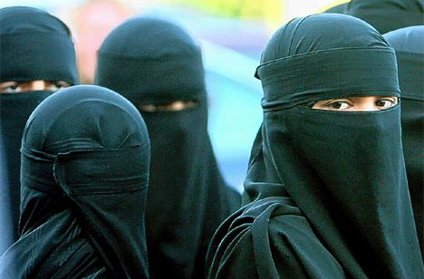
Change in Traditional Role of Women
Many folk cultures hold women to be subservient of men. Popular culture tends to empower women and increase the desire to have a greater role in society.
Legal equality and the opportunity for economic and social advancement outside the home are accepted in the west even if it is not always the case.
The negative impact of exploitation (cheap labor and prostitution)

Slide 58
Threat #2: Foreign media Imperialism
Leaders of LDCs often feel western customs brought in by television threaten traditional ways.
USA, England, and Japan dominate worldwide TV.
Only 6% of shows in Japan are foreign made
83% in Uganda.
LDCs view western TV themes of upward mobility, freedom for women, glorification of youth, and stylized violence as negative influences on their people.
Cultural Imperialism: Practice of promoting a more powerful culture over a lesser known or desirable culture.

Slide 59
Western control of the News
News is dominated by the USA and Great Britain
Poor countries purchase stories and images from the AP (associated press) and Reuters.
African and Asian governments criticize western news for not giving a balanced and well rounded view. They focus on the sensational and not the practical.
Studies show that most news IS dominated by local stories

Slide 60
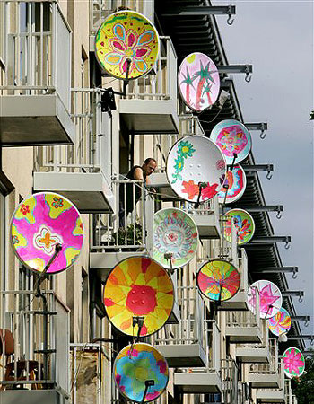
Government control of media
In the USA TV stations are owned privately.
Other parts of the world Governments own the Stations, thus control what is broadcast.
Even in Europe, stations are owned by governments. BBC for example
Governments have used TVs for propaganda and to limit what is seen. Many parts of Asia and the Middle East don’t allow outside stations and have outlawed satellite dishes.
The rapid diffusion of Satellite dishes has made this extremely difficult to control.

Slide 61
Environmental Impact #1: Modifying nature
Popular culture can significantly modify or control the environment
Folk cultures come FROM the environment. Popular sees the environment as something to modify to enhance participation in an activity or to promote the sale of a product

Slide 62
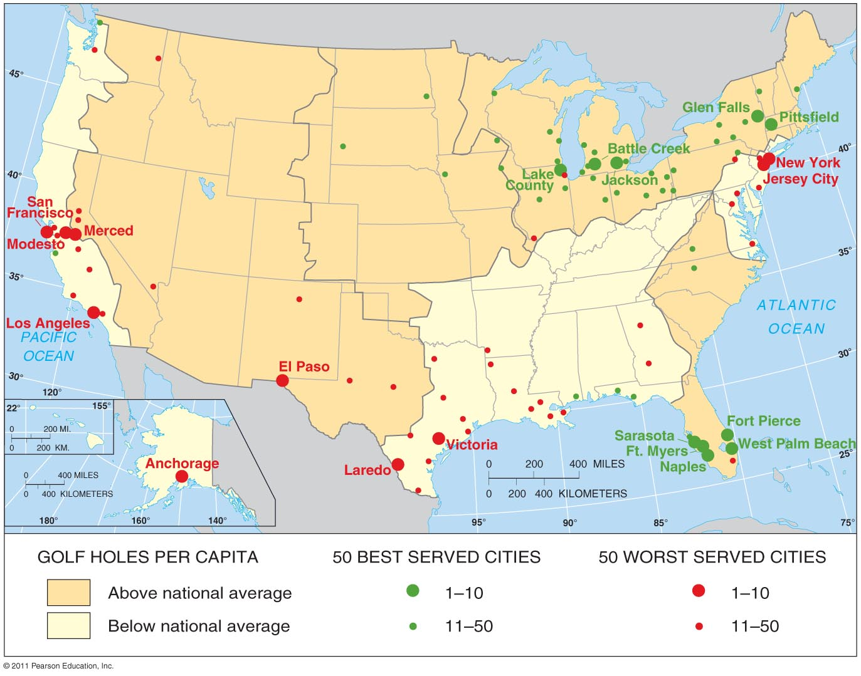
Golf Courses in Metropolitan Areas
Fig. 4-16: The 50 best-served and worst-served metropolitan areas in terms of golf holes per capita, and areas that are above and below average.

Slide 63
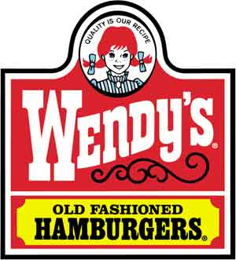
Environmental Impact #2: Uniform landscapes
Promoters of popular culture want a uniform appearance to generate greater consumption
Fast food example
Fast food is the SAME everywhere.
Locally they may be slightly different
Physical expression of uniform popular culture diffused form USA (Advertising)
Diffusion of popular cultural elements can begin anywhere and through modern technology can spread rapidly.

Slide 64
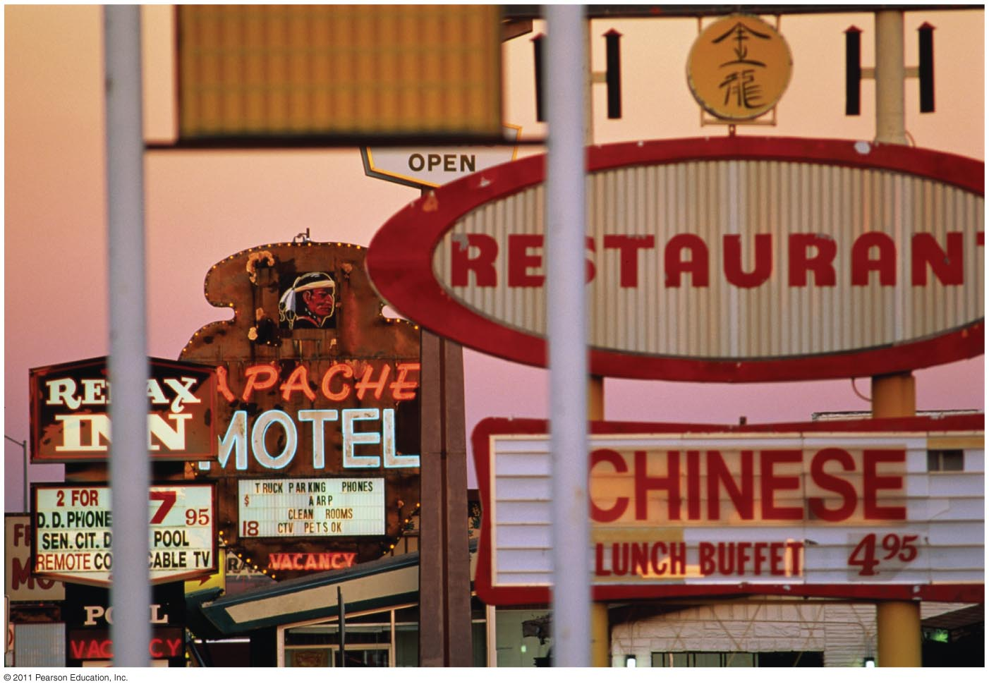
Uniform Landscapes

Slide 65
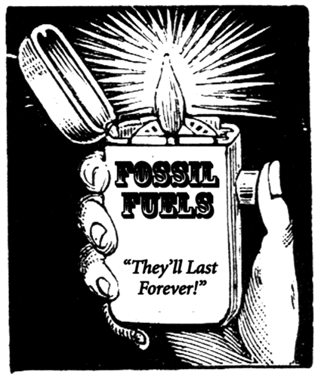
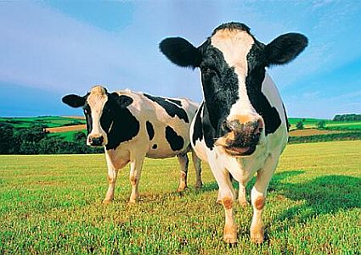
Environmental Impact #3: Negative environmental impact
Popular culture can lead to the depletion of resources
Need for energy
Fashion demands
Animal consumption is ineffective

Slide 66
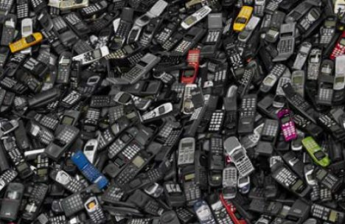
Popular culture also can lead to the pollution of the landscape.
Popular culture often produces an abundance of waste in the form of solid waste, liquid waste and various types of gasses
Technology and popular culture can produce waste, however it can also clean it up through recycling and other controls on the production of waste.

